Slide 1
Ireland’s Mythical Creatures & Legends
An Introduction to the Irish Fae and Folklore
By Sarah Moje via www.BrightHubEducation.Com

Slide 2
The Myths of Ireland
The Emerald Isle has a long history of folklore.
The ancient societies of Ireland, the Celtics and the Druids believed very strongly in magic.
These beliefs were passed down through oral and written tradition and survive in some form to this day.

Slide 3
The Banshee
A female ghost who carried the omen of death.
She could appear in several forms: and old woman in rags, a beautiful young girl, or an Irish washwoman who cleaned bloody rags.
When she was seen, she screamed a horrible cry.
Legend says her scream brought death to the family who heard it.

Slide 4
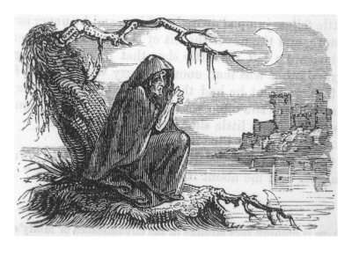

Slide 5
The Pookas
A Pooka is a fairy, but a rather troublesome one.
They appear at night in rural Ireland and on the sea.
If the Pooka is having a good day, they may only destroy a farm.
If a Pooka is having a bad day, it will stand in the field and call to family members by name. When the family member came out, the Pooka would steal them away.

Slide 6
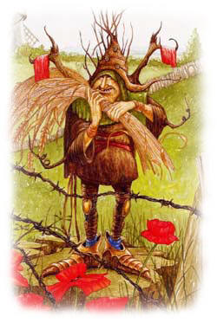

Slide 7
The Changelings
The legend of a changeling is a very old Irish legend.
Female fairies give birth to deformed children.
Fairies would then go into the human world and swap their baby for a pretty human baby.
Changelings looked like unattractive human babies, but were not human.
The only time a changeling baby laughed or smiled is when misfortune befell its family.

Slide 8
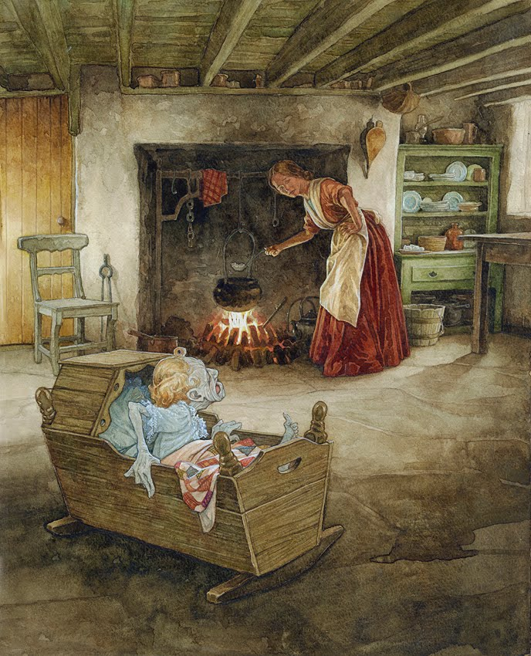

Slide 9
The Leprechauns
The most famous type of Irish fairy.
Tall fairies that look like old men.
They love to collect gold which they hide at the end of a rainbow.
If a human can catch a leprechaun, the fairy must give that human 3 wishes before he can be let go.

Slide 10
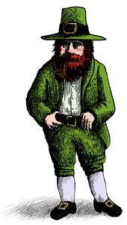

Slide 11
Finn MacCool
Finn is a warrior of Irish myths.
He appears in a great many Irish legends.
He is reputed to have all the knowledge in the world.
He carried the knowledge in his thumb and whenever he wanted to learn something, he just had to suck his thumb.

Slide 12
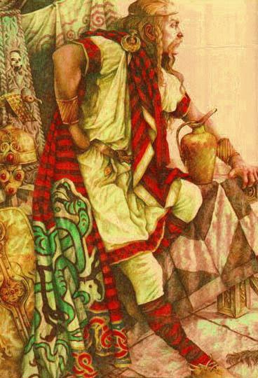

Slide 13
Saint Patrick
Born in Britain; he was not Irish.
He was kidnapped as a child and sold into slavery in Ireland.
While a slave, he became a Christian and spent the rest of his life teaching the Irish about Christianity.
He was forgotten for years after his death.
Irish monks created his legend, telling the tale that he drove the snakes out of Ireland.
The snakes symbolized pagans, and St. Patrick symbolized Christianity.

Slide 14
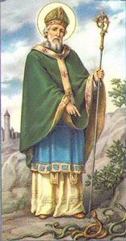

Slide 15
The Shamrock
3 green leaves of the Shamrock has a history with all of Ireland’s historical cultures.
Druids believe it was a plant that could ward off evil.
Celtics believed the heart shaped leaves made it a mystical plant.
Christians believed the three leaves represented the Holy Trinity.
No wonder it is the symbol of all things Irish.

Slide 16
