Slide 1
Advertisements

Slide 2
What is an advertisement?
An advertisement is something that a company intentionally uses to try to promote and sell their product.

Slide 3
Types of adverts
Television commercials
Billboards
Magazine
Internet

Slide 4
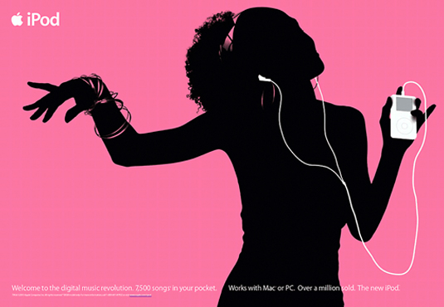

Slide 5
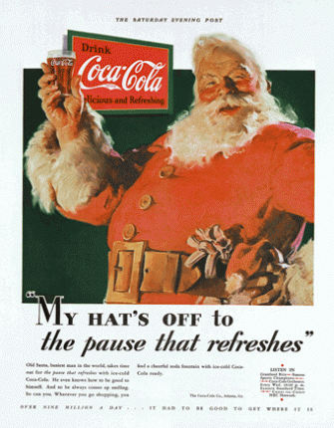

Slide 6
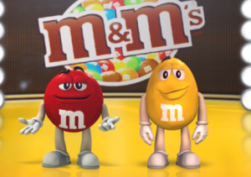

Slide 7
What makes a good advert?
It gets your attention.
You remember it for a long time.
It makes you want the product.
It makes the product look appealing.

Slide 8
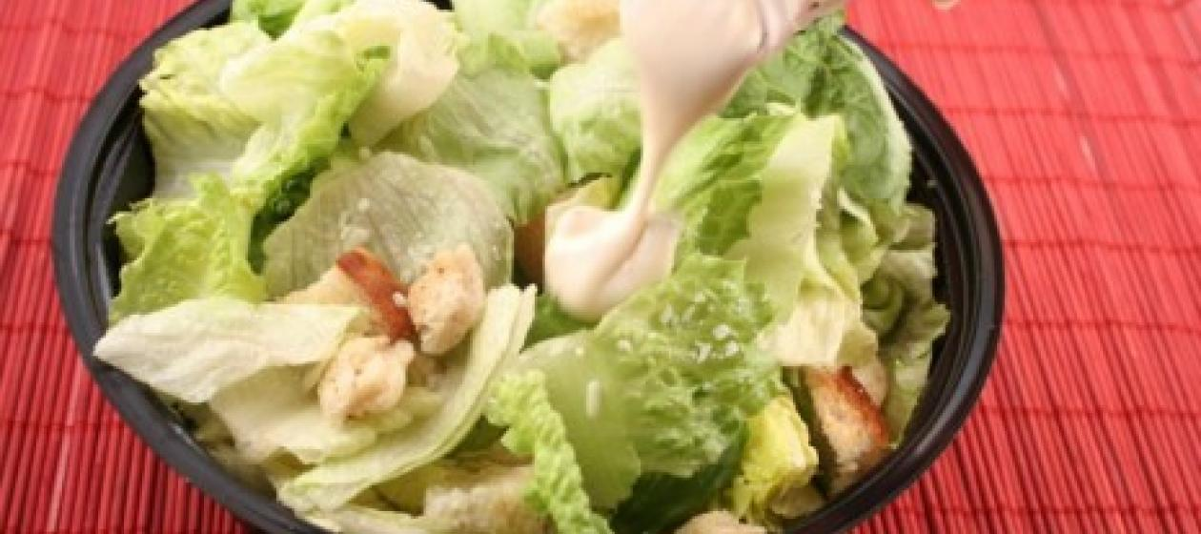
Would you rather buy this?

Slide 9
Or this?

Slide 10
Why is the second advert more effective?
The camera looks sharper
The salad looks fresher
The background looks comfortable
There is a beautiful woman eating the salad.

Slide 11
Why are those things effective?
It is the same salad, but the way it is shown make us think differently
I can be beautiful if I eat this salad
A beautiful woman will be there if I eat this salad
I can eat this salad in the comfort of my home

Slide 12
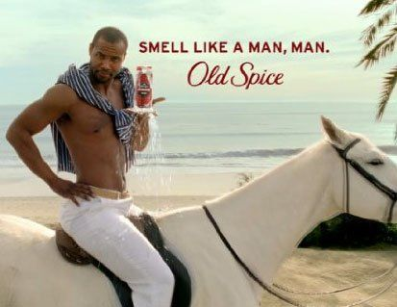
Internet adverts (viral videos)

